Slide 1



AI-Powered Fresh Fruit Bunch (FFB) Ripeness Grading System
Automating oil palm FFB quality assessment to eliminate human error, optimize extraction rates, and prevent revenue leakage.
Primary Research Basis Judijanto (2026) & Industry Literature
Target Objective Automated Industrial Ripeness Classification
Key Metric Up to 99.1% Sorting Accuracy

Slide 2
Executive Summary
Operationalizing machine vision to transition oil palm processing mills from subjective manual grading to objective, high-precision automated AI inspection.

Slide 3






The Problem: Manual Grading Gaps
1. Business & Profit Impact
2. Quality & Yield Losses
3. Operational Friction
Manual grading exhibits human error rates up to 74% with inter-grader variance between 15–35%, driving $50K–$100K in annual losses for a 100-ton daily mill (Judijanto, 2026).
Under-ripe fruit reduces Oil Extraction Rate (OER) by 2–5% per cycle. Over-ripe fruit raises Free Fatty Acid (FFA) levels, elevating processing costs by 8–12% (Judijanto, 2026).
Graders rely on subjective visual inspections under inconsistent ambient lighting and fatigue (Mansour et al., 2022), leading to recurring price disputes between growers and mill operators.

Slide 4


Key Research & Benchmark Statistics
Metric Benchmark | Recorded Value | Operational Impact & Source Context
Human Error Rate | 74% Error | Measured directly in FFB sorting departments (Tumanggor et al., 2022)
Grader Disagreement | 15 – 35% Variance | High inter-observer classification inconsistency (Judijanto, 2026)
Yield Reduction | 2 – 5% Loss | Direct reduction in Oil Extraction Rate (OER) from under-ripe FFB (Judijanto, 2026)
Processing Cost Surge | +8 – 12% Cost | Elevated Free Fatty Acid (FFA) refining expense from over-ripe FFB (Judijanto, 2026)
Annual Financial Loss | $50K – $100K / yr | Estimated direct annual revenue loss for a standard 100-ton/day mill (Judijanto, 2026)

Slide 5
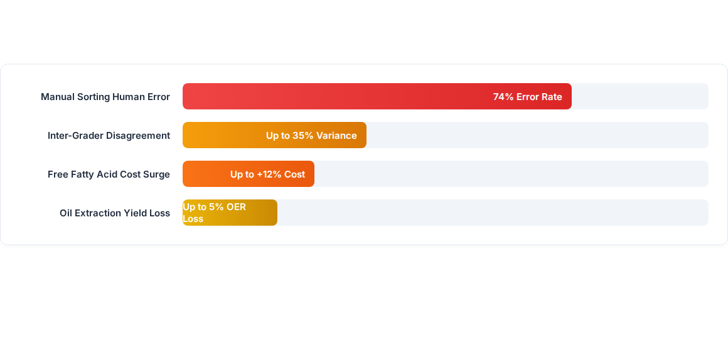
Quantifying the Operational Impact
Figure: Empirical industry metrics highlight severe financial and operational compounding risk caused by reliance on manual visual grading systems.

Slide 6

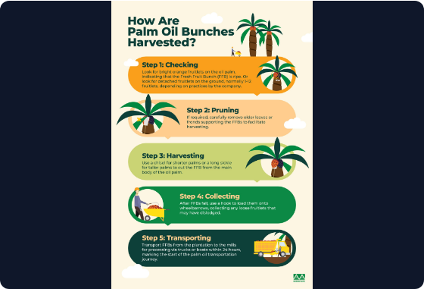
Solution 1: Lightweight Edge AI System
✓
Architecture: Edge computer vision deploying YOLOv8 optimized for Android or NVIDIA Jetson Nano hardware.
✓
Accuracy: Achieves a proven 94.37% mAP (Mean Average Precision) for real-time visual grading (Junos et al., 2024).
✓
On-Site Deployment: Enables instant, offline field grading at ramp inspection points without requiring high-bandwidth cloud access.
✓
Key Advantage: Extremely low deployment cost and immediate mobility for ramp supervisors.

Slide 7
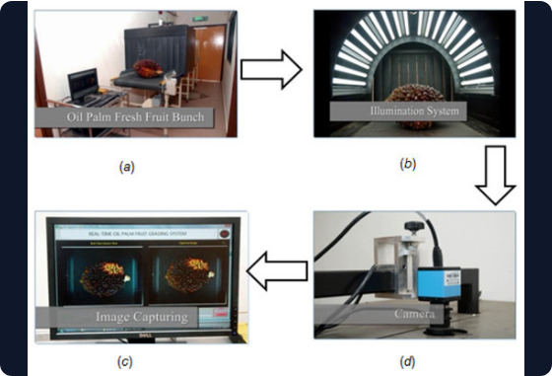
Solution 2: Color & Texture Hybrid Model
✓
Feature Extraction: Dual-stream image processing utilizing Artificial Neural Networks (ANN).
✓
HSV Color Histograms: Captures color transitions from blackish-purple (unripe) to bright reddish-orange (ripe).
✓
GLCM Texture Analysis: Evaluates surface roughness and spike distribution patterns for fine-grained sorting.
✓
Classification Performance: Reaches 98.3% classification accuracy under controlled lighting environments (Septiarini et al., 2021).

Slide 8
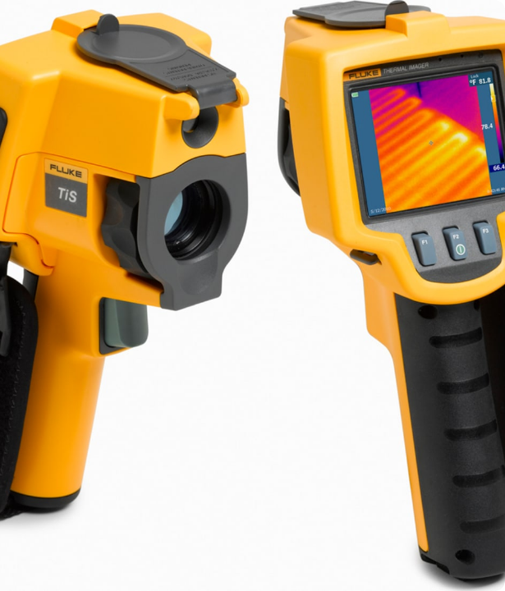

Solution 3: Thermal Inspection
Non-Destructive Thermal Station
Integrates thermal infrared sensing to inspect internally radiated heat differentials between fruitlets, stalks, and canopy debris.
Bypasses surface visual glare and dirt contamination, delivering an industry-leading 99.1% classification accuracy (Zolfagharnassab et al., 2022).
Highest Accuracy Standard: Ideal for high-throughput conveyor line integration.

Slide 9


Solution Matrix & Recommendation
Option / Solution | Core Technology | Accuracy Benchmark | Primary Benefit / Best Fit
Solution 1: Edge AI App | YOLOv8 on Jetson Nano / Mobile | 94.37% mAP | Fastest deployment & mobile field ramp inspections
Solution 2: Hybrid ANN | HSV Histograms + GLCM Texture | 98.3% Accuracy | High precision sorting under controlled conveyor lighting
Solution 3: Thermal Station | Infrared Thermal Sensing | 99.1% Accuracy | Ultimate precision sorting resistant to dirt & surface glare

Slide 10
Questions & Discussion
Transforming Palm Oil Milling Efficiency through AI Vision Technology

Slide 11



Image Sources
https://www.musimmas.com/wp-content/uploads/2022/05/How-are-oil-palm-bunches-harvested-scaled.jpg
Source: www.musimmas.com
https://www.mdpi.com/agriculture/agriculture-12-01461/article_deploy/html/images/agriculture-12-01461-g003-550.jpg
Source: www.mdpi.com
https://res.cloudinary.com/iwh/image/upload/q_auto,g_center/w_1500,e_trim,c_fill,g_auto/assets/1/26/tis_image_4.jpg
Source: www.tequipment.net

